Slide 1

Personalized Email Generator: A Powerful AI Solution
This presentation outlines the design and development of a personalized email generator, leveraging AI to streamline email creation and boost engagement
by
-G Tejashwini
-T chidwila
-U Nikhitha
-G Rochisna

Slide 2
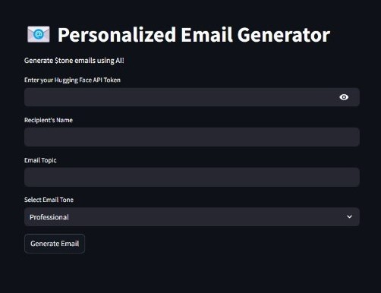
Architecture: Frontend (Streamlit & Python)
Intuitive Interface
A user-friendly Streamlit interface allows for easy input of recipient data, tone, purpose, and relevant keywords.
Sreamlit is used for the first code block,allowing users to input data and view the AI-generator email.
Real-Time Preview
The UI provides a real-time preview of the generated email, enabling instant feedback and adjustments.

Slide 3
Architecture: Backend (Python & Hugging Face)
Model Selection
The backend leverages pre-trained language models from Hugging Face, like BigScience Bloom and
Falcon – 7B , for email generation.
Model Fine-Tuning
These models can be fine-tuned on industry-specific data to ensure tailored and relevant content for each email.
API Integration
A seamless API connects the frontend with the backend, enabling real-time data transfer and email generation.
Model | Type | Details
Falcon-7B instruct | Transformer-based LLM | Optimized for instruction-based tasks.
BigScience BLOOM | Transformer-based LLM | A multilingual , open-weight model capable of generating coherent text in different languages.

Slide 4
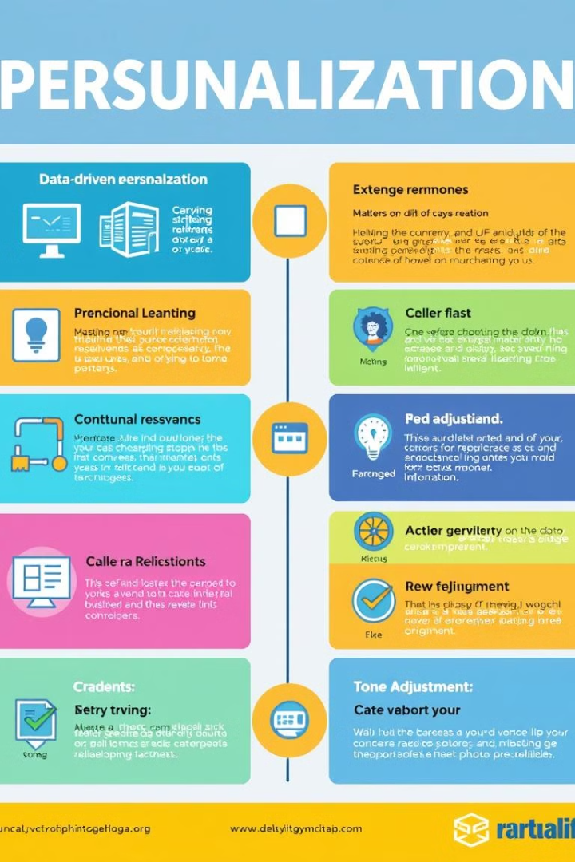
Personalization Techniques
Data-Driven Customization
Contextual Relevance
The system uses recipient data like name, company, and role to personalize email content.
Content adapts to the email's purpose, ensuring relevance and value for the recipient.
Tone Adjustment
The email's tone is tailored to the audience, whether it's formal, informal, or persuasive.

Slide 5




Implementation Details
Python libraries such as Transformers, Streamlit, Pandas, and Scikit-learn are used for data processing, model interaction, and UI development.
The backend utilizes Hugging Face models like Falcon – 7B, BigScience BLOOM to generate personalized email content and store in Mongodb.
API endpoints define the input/output data formats for seamless communication between the frontend and backend.

Slide 6
Results and Demo
Increased Open Rates
1
Personalized emails result in significantly higher open rates, demonstrating improved recipient engagement.
Higher Click-Through Rates
2
Personalized content drives users to click on links within the email, increasing website traffic and engagement.
Improved Conversion Rates
3
Personalized emails effectively convert recipients into customers, boosting sales and business outcomes.

Slide 7



Challenges and Solutions
Data Privacy
Ensuring GDPR compliance and data security is paramount. We implement data anonymization techniques and secure data storage practices.
Model Accuracy
To mitigate bias and ensure high-quality emails, we utilize bias detection techniques and continuous model evaluation.
Scalability
We employ infrastructure optimization techniques to handle a large volume of requests while maintaining email generation speed.

Slide 8
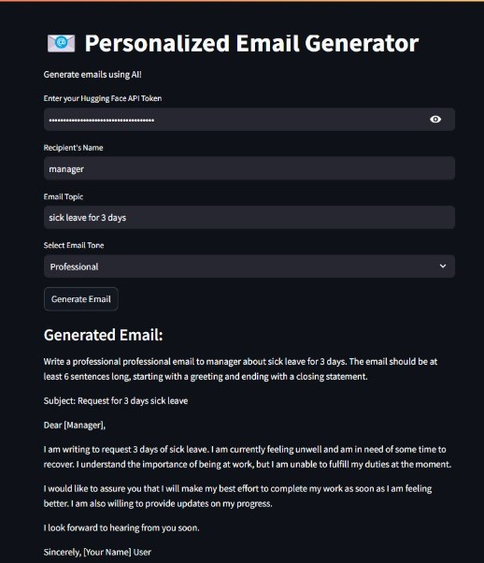
OUTPUT:

Slide 9
Conclusion and Future Directions
Project Achievements
The personalized email generator successfully automates email creation, increases engagement, and improves conversion rates.
Future Enhancements
We plan to incorporate multilingual support, A/B testing capabilities, and sentiment analysis features
Call to Action
We encourage adoption of this powerful solution and invite collaboration to further advance email personalization.

Slide 10
THANK YOU

